Slide 1

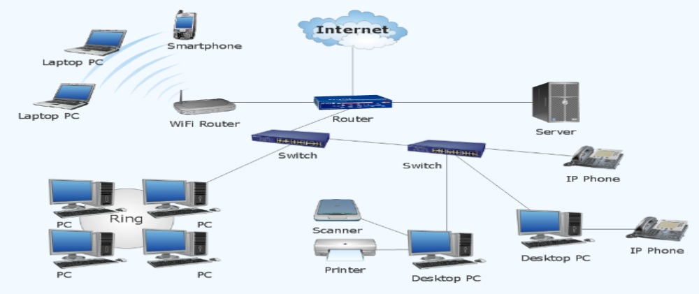
Chapter One
INTRODUCTION
Data Communication and Computer Networks
Data Communication and Computer Networks
Chapter One
INTRODUCTION

Slide 2
Main topics
Data Communication Basics
Introduction to Computer Networks
Transmission Medias
Network Protocol Stacks

Slide 3
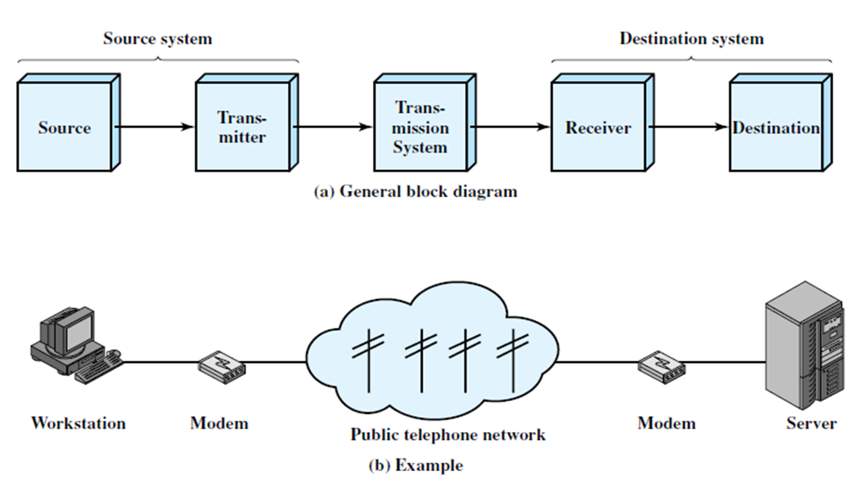
Communication Basics
Data communications (Transmission) are the exchange of data between two devices via some form of transmission medium such as a wire cable.
For data communications to occur, the communicating devices must be part of a communication system made up of a combination of hardware (physical equipment) and software (programs).
The following figures show, the general (simplified) data communication model and the communication between a workstation and a server computer system over a public telephone network with all necessary hardware devices in each stages of simplified communication model.
Notes:
It includes :
Writing and talking
Nonverbal communication (such as facial expressions, body language or gestures)
Visual communication (the use of images or pictures such as painting, photography, video or film)
Electronic Communication such as telephone calls, electronic mail, cable television, satellite broadcasts.

Slide 4
Five components of data communication
Message: is the information (data) to be communicated. Popular forms of information include text, numbers, pictures, audio, and video.
Sender: is the device that sends the data message. It can be a computer, workstation, telephone handset, video camera, and so on.
Receiver: is the device that receives the message. It can be a computer, workstation, telephone handset, television, and so on.
Transmission medium: is the physical path by which a message travels from sender to receiver. Some examples of transmission media include twisted-pair wire, coaxial cable, fiberoptic cable, and radio waves.
Protocol: is a set of rules that govern data communications. It represents an agreement between the communicating devices. Without a protocol, two devices may be connected but not communicating, just as a person speaking French cannot be understood by a person who speaks only Japanese.
Notes:
Transmission system: This can be a single transmission line or a complex network devices for interconnection source and destination systems.

Slide 5
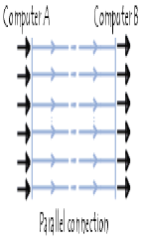
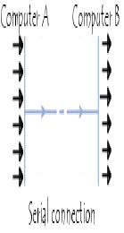
Serial vs. parallel communications
In serial communications
  A single bit will be transferred at a time using the communication channel.
  Bits will be reassembled at the destination
  Mostly used by computer peripherals like printers,(why do they use such type of communication?)
In parallel communications
  Multiple bits (eg. Eight bits) will be transferred at a time
  Needs multiple (parallel) communication channels

Slide 6
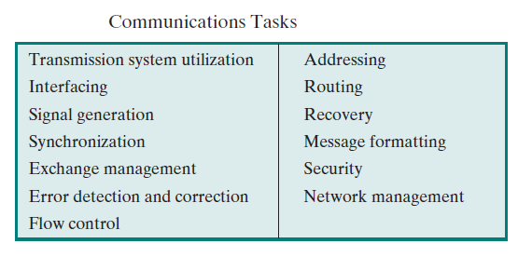
Communication tasks
The table lists some of the key tasks that must be performed in a data communications system.
The list is somewhat arbitrary: Elements could be added; items on the list could be merged; and some items represent several tasks that are performed at different “levels” of the system (i.e. data communication system). However, the list as it stands is suggestive of the coverage of this course.

Slide 7
Data Representation Techniques
The terms analog and digital correspond to continuous and discrete, respectively.
These two terms are used frequently in data communications in at least three contexts: data, signaling, and transmission.
Data is an entities that convey meaning, or information.
Signals are electric or electromagnetic representations of data.
Signaling is the physical propagation of the signal along a suitable medium.
Transmission is the communication of data by the propagation and processing of signals.
The next slide demonstrate how the digital and analog data and signals can be processed and propagated using different communication devices in the network.
Both analog and digital signals may be transmitted on suitable transmission media. The way these signals are treated is a function of the transmission system.
Notes:
Network is a system in which a number of independent computers are linked together to share data and peripherals, such as hard disks and printers (more in the next chapters)

Slide 8
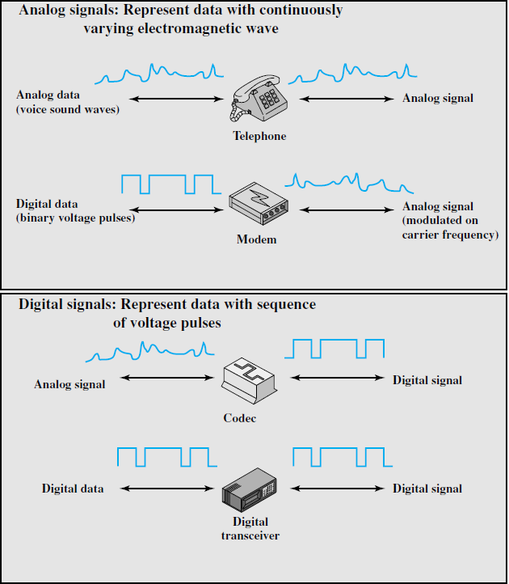
Data Representation Techniques cont’d…

Slide 9
Description of data representation Technique
Analog Signal | Digital signal
Continuous wave that carries information by altering the characteristics of waves Analog signal has infinitely many levels of intensity over a period of time It measures rather than counts Example : Voice and all sounds are analog, traveling to human ears in the forms of waves. Require amplifier | Discrete on-off pluses that carry covey information in terms of 0s and 1s just like CPU It counts but not measures Discrete pluses of data transmission rather than continues wave More prevalent in computer based devices Require repeater

Slide 10
Data transmission Formats
Analog transmission is a means of transmitting analog signals without regard to their content; the signals may represent analog or digital data.
In either case, the analog signal will become weaker (attenuate) after a certain distance. To achieve longer distances, the analog transmission system includes amplifiers that boost the energy in the signal.
Unfortunately, the amplifier also boosts the noise components. With amplifiers cascaded to achieve long distances, the signal becomes more and more distorted.

Slide 11
Data Transmission Formats cont’d…
Digital transmission, a digital signal can be transmitted only a limited distance before attenuation, noise, and other impairments endanger the integrity.
To achieve greater distances, repeaters are used. A repeater receives the digital signal, recovers the pattern of 1s and 0s, and retransmits a new signal. Thus the attenuation is overcome.
The question naturally arises as to which is the preferred method of transmission. Both telecommunications facilities and intra-building services have moved to digital transmission and, where possible, digital signaling techniques.
  The most important reasons are the following:
        Digital technology
        Data integrity
        Capacity utilization
        Security and privacy

Slide 12
Signal Encoding Technique
Digital data, digital signals: it is to assign one voltage level to binary one and another to binary zero.
Digital data, analog signal: it converts digital data to an analog signal so that it can be transmitted over an analog line.
The basic techniques are amplitude shift keying (ASK), frequency shift keying (FSK), and phase shift keying (PSK). All involve altering one or more characteristics of a carrier frequency to represent binary data.
Analog data, digital signals: the simplest technique is pulse code modulation (PCM), which involves sampling the analog data periodically and quantizing the samples.
Analog data, analog signals: these are modulated by a carrier frequency to produce an analog signal in a different frequency band, which can be utilized on an analog transmission system.
The basic techniques are amplitude modulation (AM), frequency modulation (FM), & phase modulation (PM).

Slide 13
Transmission Impairments
Impairments are communication problems (barriers) that could cause the signal degradation (signal quality loss or bit level change) in the time data communication among or between communication devices.
For analog signals, these impairments can degrade the signal quality.
For digital signals, bit errors may be introduced, such that a binary 1 is transformed into a binary 0.
The most common impairments are:
      Attenuation and attenuation distortion
      Delay distortion
      Noise
Notes:
Impairment =>making the device not work correctly

Slide 14
Attenuation
Attenuation is the reduction in the power of a signal as it is transmitted.
Attenuation is a problem because the signal eventually loses so much power that it becomes difficult to distinguish it from the thermal noise in the background.
Attenuation introduces three considerations for the transmission engineer.
        First, a received signal must have sufficient strength so that the electronic circuitry in the receiver can detect the signal.
        Second, the signal must maintain a level sufficiently higher than noise to be received without error.
        Third, attenuation varies with frequency

Slide 15
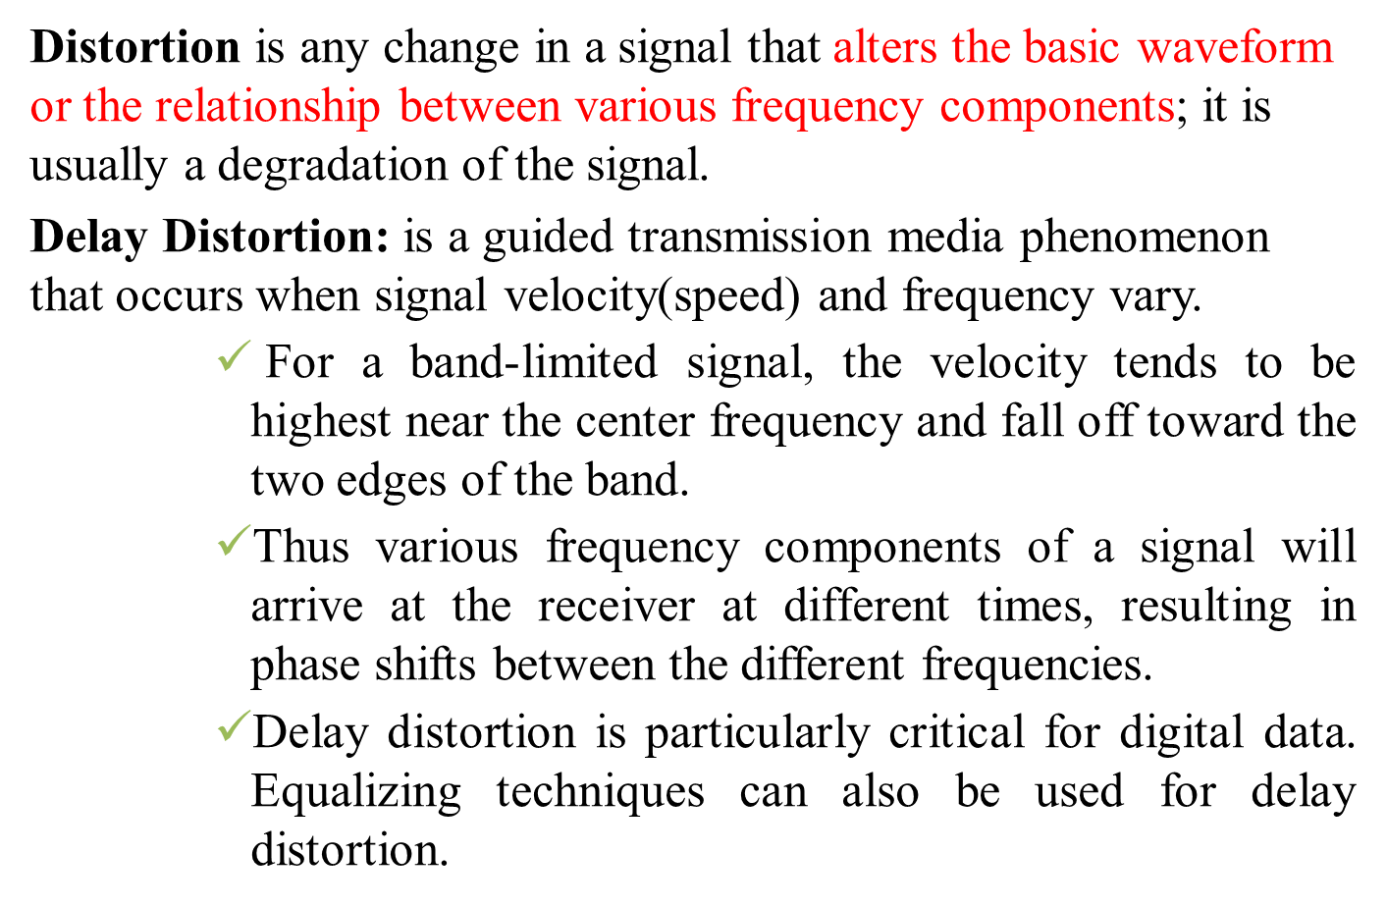
Delay distortion

Slide 16
Transmission Impairments cont’d…
Noise :is a summation of unwanted or disturbing energy from natural and sometimes man-made sources or it is unwanted signals that are inserted somewhere between transmission and reception.
It is a major limiting factor in communications system performance.
Noise may be divided into four categories:
  Thermal noise: is due to thermal agitation of electrons.
  Intermodulation noise: is a situation when signals at different frequencies share the same transmission medium.
  The effect of intermodulation noise is to produce signals at a frequency that is the sum or difference of the two original frequencies or multiples of those frequencies.
  Crosstalk: is an unwanted coupling between signal paths.
  Impulse noise: is non-continuous, consisting of irregular pulses or noise spikes of short duration and of relatively high amplitude.

Slide 17
Modes of data transmission
There are 3 different transmission modes characterized according to the direction of the exchanges:
A simplex connection is a connection in which the data flows in only one direction, from the transmitter to the receiver.
  This type of connection is useful if the data do not need to flow in both directions (for example, from your computer to the printer or from the mouse to your computer...).

Slide 18
Contd.
A half-duplex connection (sometimes called an alternating connection or semi-duplex) is a connection in which the data flows in one direction or the other, but not both at the same time.
  With this type of connection, each end of the connection transmits in turn.
  This type of connection makes it possible to have bidirectional communications using the full capacity of the line.
  In a half-duplex transmission, the entire capacity of a channel is taken over by whichever of the two devices is transmitting at the time.
  Walkie-talkies and CB (citizens band) radios are both half-duplex systems.
  The half-duplex mode is used in cases where there is no need for communication in both directions at the same time; the entire capacity of the channel can be utilized for each direction.

Slide 19
Contd.
Full-Duplex: In full-duplex mode (also called duplex), both stations can transmit and receive simultaneously
  The full-duplex mode is like a two-way street with traffic flowing in both directions at the same time.
  In full-duplex mode, signals going in one direction share the capacity of the link: with signals going in the other direction.
  This sharing can occur in two ways: Either the link must contain two physically separate transmission paths, one for sending and the other for receiving; or the capacity of the channel is divided between signals travelling in both directions.
  One common example of full-duplex communication is the telephone network. When two people are communicating by a telephone line, both can talk and listen at the same time.
  The full-duplex mode is used when communication in both directions is required all the time.
  The capacity of the channel, however, must be divided between the two directions.

Slide 20
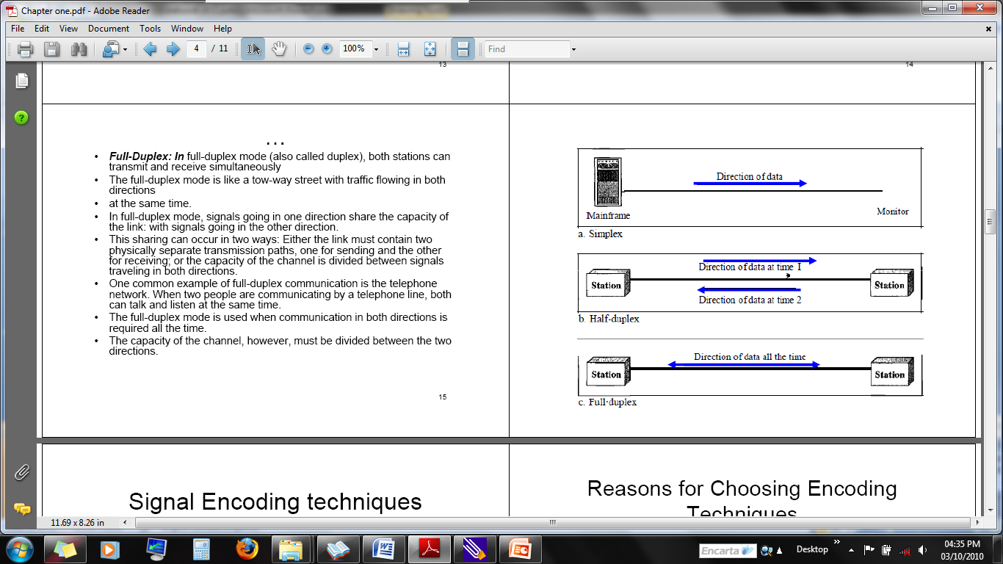
Contd.

Slide 21
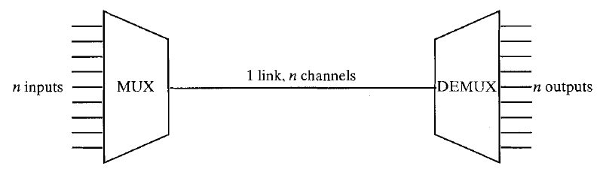
Multiplexing
In data communication, there might be a need to share a single media for multiple communication (media sharing)
Sharing of a single media (fiber, coaxial, microwave,..) is known as multiplexing.
In the above figure, there are n inputs to a multiplexer. The multiplexer is connected by a single data link to a de multiplexer.

Slide 22
Contd.
The link is able to carry n separate channels of data.
The multiplexer combines (multiplexes) data from the n input lines and transmits over a higher capacity data link.
The de multiplexer accepts the multiplexed data stream, separates (de multiplexes) the data according to channel, and delivers them to the appropriate output lines.

Slide 23
Types of Multiplexing
Frequency-division multiplexing (FDM)
Time-division multiplexing (TDM)
Code division multiplexing(CDM)

Slide 24
Frequency-division Multiplexing
FDM is a signal transmission technology in which multiple signals can simultaneously be transmitted over the same line or channel.
Frequency-division multiplexing (FDM) can be used in both wired and wireless networking for transmitting large amounts of data at high speeds.
FDM is the simplest and oldest form of multiplexing in wireless networking technology.
Frequency division multiplexing involves simultaneously transmitting multiple signals on different frequencies.

Slide 25
Contd.
These different frequencies, called channels, share non-overlapping portions of the total frequency band being used.
Signals from different data sources are fed into a multiplexer that modulates each signal and transmits them at different frequencies.
These signals are then transmitted over the wire or through wireless communication and are separated at the destination into individual data signals using a demultiplexer.

Slide 26
Time-division multiplexing (TDM)
A multiplexing method for transmitting multiple data streams in a single communication path.
In TDM, the data from different input channels is divided into fixed-length segments and then combined in round-robin fashion into a single output data stream, which can then be transmitted over a single channel transmission system and demultiplexed at the destination location.
The segments can be created by the multiplexer itself or can be inherent in the input channel signals, such as fixed-length frames.

Slide 27
Contd.
For example, if input streams A, B, and C are divided into segments as shown here:
  A: A1, A2, A3,...
  B: B1, B2, B3,...
  C: C1, C2, C3,...
    the output stream will look like this:
  MUX(ABC) A1, B1, C1, A2, B2, C2, A3, B3, C3,...
One weakness in TDM is that if an input channel does not have anything important to carry for a time, empty segments are inserted into the output stream anyway. For example, if channel A is not transmitting data, one-third of the output channel is not being used. You can overcome this weakness by using a more sophisticated multiplexing technique called statistical multiplexing.
Notes:
Statistical multiplexing dynamically allocates bandwidth to each channel on an as-needed basis. This is in contrast to time-division multiplexing (TDM) techniques, in which quiet devices use up a portion of the multiplexed data stream, filling it with empty packets. Statistical multiplexing allocates bandwidth only to channels that are currently transmitting.

Slide 28
Code Division Multiple Access(CDMA)
It allows each station to transmit over the entire frequency spectrum all the time. Multiple simultaneous transmissions are separated using coding theory. Thus, the key to CDMA is to be able to extract the desired signal while rejecting everything else as random noise.
In CDMA, each bit time is subdivided into m short intervals (for example 8 chips/bit) called chips.
Each station is assigned a unique m-bit code called a chip sequence.
For example, it is convenient to use a bipolar notation to write these codes as sequences of −1 and +1. To transmit a 1 bit, a station sends its chip sequence. To transmit a 0 bit, it sends the negation of its chip sequence. Thus, for m = 8, if station A is assigned the chip sequence (−1 −1 −1 +1 +1 −1 +1 +1), it can send a 1 bit by transmitting the chip sequence and a 0 by transmitting (+1 +1 +1 −1 −1 +1 −1 −1).

Slide 29
Code devisor Multiplexing cont’d…..
Example: Let d1 and d2 are a set of data which are going to sent and c1 and c2 are a code.
Assume d=1 and d2=0
To find the common channel we should multiply a given data which a given code.
Common channel=d1.c1+c2.d2……….
Chip sequence data representation
C1=+1 +1 +1 +1 0=>-1 and 1=> +1
C2=+1 -1 +1 -1
Station one use the channel as d1.c1=> (+1)(+1 +1 +1 +1)=+1 +1 +1 +1
Station 2 as d2.c2 => (-1)(+1-1+1-1) =-1 +1 -1 +1
Common channel =(+1 +1 +1 +1)+(-1 +1 -1 +1) which is multiplexing
The receiver side or the de multiplexing process can represent as the following
Assume that station 1 want to receive station 2’s data, so in order to do this we should have to multiply common channels data with station 2’s code.
(+1 +1 +1 +1)+(-1 +1 -1 +1) (+1 -1 +1 -1 )=+1-1+1-1-1-1-1+1
= -2 then divide the result gain by the number of channels in our case number of channels =2
-2/2=-1 which is station 2’s data

Slide 30
Data Transmission : Error Detection and Correction
Errors in transmitted data can occur for a variety of reasons.
Some errors are due to equipment failure.
Some errors are due dispersion in optical fibers (i.e. light pulses spread out).
Some errors are due to attenuation (loss of signal power over a line).
Most errors are due to thermal noise that occurs naturally on the line.

Slide 31
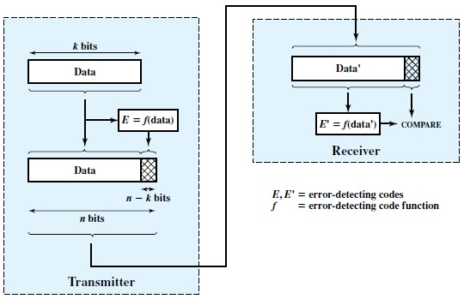
Detecting Errors
We need to build systems that are resilient to errors in data.
There is no way to guarantee that all bits will be sent uncorrupted.
One way to cope with this is to detect errors and request that corrupted data should be retransmitted.
Because errors occur randomly, there is no way of knowing with complete certainty if the data is correct.
The best we can do is detect most errors.
Notes:
Detecting errors cannot be guaranteed either. We can at least make it extremely unlikely that errors will go undetected.

Slide 32
Parity Checking (Vertical Redundancy Check (VRC)
One of the most common ways of checking to see if an error is to count the bits in a character to see if there is an even or odd number.
Before transmission, an extra bit (parity bit) is appended to the character to force the number of bits to be even (or odd).
If the received character does not have an even (or odd) number of bits then an error must have occurred.

Slide 33
Parity
Both the sender and receiver must know which form of parity to use.
A character such as 0110001 would be transmitted as:
Parity checking will detect a single error in a character but not double errors.
Odd Parity: 01100010 (There are an odd number of 1s)
Even Parity: 01100011 (There are an even number of 1s)

Slide 34
Hamming Distance
The Hamming distance between two bit patterns is the number of dissimilar bits.
It measures the minimum number of substitutions required to change one string into the other, or the number of errors that transformed one string into the other.
For example, the Hamming distance between 01000001 (‘A’) and 01000011 (‘C’) is 1 because there is only one dissimilar bit.
One error in the wrong place can turn an ‘A’ into a ‘C’.

Slide 35
Hamming Distance
The Hamming distance between 01000001 (‘A’) and 01000010 (‘B’) is 2 because there are two dissimilar bits.
It would take two errors in the wrong place to turn an ‘A’ into a ‘B’.
Adding a parity bit ensures that there is at least a Hamming distance of 2 between any two code words.

Slide 36
Checksum
Another simple way of checking if there has been an error in a block of data is to find a checksum.
Imagine we send the data 121, 17, 29 and 47. Adding these numbers up, we get 214.
We actually send 121,17,29,47 and 214.
The receiver can total up the first numbers and compare it to the last one.
A difference means an error has occurred.
Typically pairs of bytes are joined to make 16 bit numbers. It is these 16 bit numbers that are totaled to make the checksum.
If the checksum becomes larger than 65535 (the largest possible 16 bit number) then the carried bits are discarded.
Checksums are common but not particularly good at catching errors. Later errors can easily hide earlier ones.
Notes:
Hexa decimal addition
989A
987B
Sender side
1. Add a given number in column and divide each column by 16
add carry(complete divide value to the next column ) and put the remainder in existing column
This give as total value of a given data
2. Find once complement by subtracting total value of each column from 15 the value we gained from this is called check sum of sender side
Receiver side
1, add a number in given column according to sender side calculation and dived by 16 in a given Colum or repeat step one
2. Add check sum value with total data value then check error

Slide 37
Check sum…..
Example
Given an segmented of 32bit data 10011001111000100010010010000100
Then detect the error using check sum
Senders side
To do this follow the following steps
1.Segment the data into 8 bits as the following
10011001
11100010
00100100
10000100
2. Sum the data to find check sum
10011001
11100010
00100100
10000100
1000100011 since the result contains 10 bits wrapped around 2 bits

Slide 38
Check sum…..
00100011+10=00100101
3. Find 1’S complement(change 0->1 and 1->0) of the above 8 bits
check sum = 11011010
Receiver side
4. All segment along with check sum value are added
sum of total data+ check sum
00100101+11011010=11111111
5.Then to find the original data and check if error is occurred by complementing the above data. If the complement data =0 the data is free from errors but if the result is different the data contains error there fore error correction mechanism should be applied to correct it.
1’s 11111111=00000000 there fore this data is free from errors

Slide 39
Cyclic Redundancy Code (CRC)
A far more effective way of detecting errors in a block of data is to use a Cyclic Redundancy Code.
In CRC, a number is mathematically calculated for a packet by its source computer, and then recalculated by the destination computer.
If the original and recalculated versions at the destination computer differ, the packet is corrupt and needs to be resent or ignored.

Slide 40
The mathematical procedure for performing a CRC is specified by the International Telecommunication Union (ITU) and involves applying a 16-bit polynomial to the data being transmitted by the packet for packets of 4 KB of data or less, or a 32-bit polynomial for packets larger than 4 KB.
The results of this calculation are appended to the packet as a trailer. The receiving station applies the same polynomial to the data and compares the results to the trailer appended to the packet. Implementations of Ethernet use 32-bit polynomials to calculate their CRC.

Slide 41
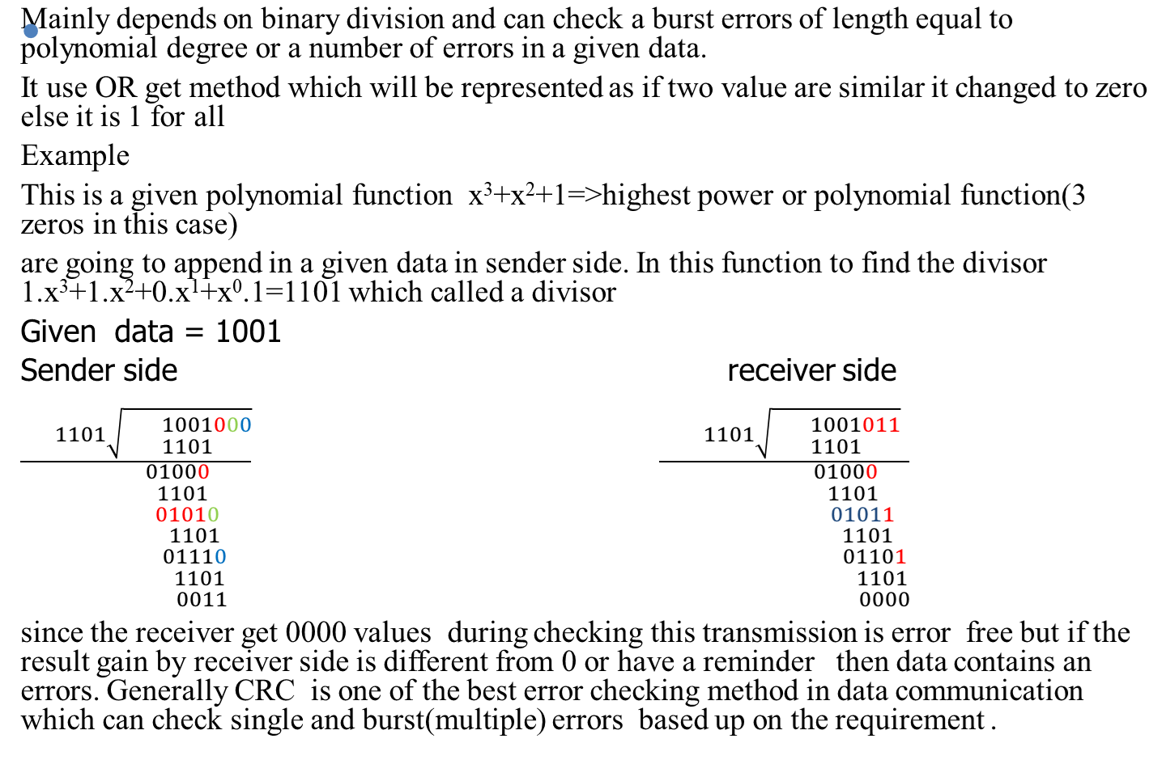
Cyclic redundancy check(CRC)

Slide 42
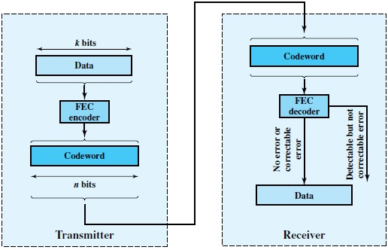
Error correction
Correction of errors using an error-detecting code, requires that block of data be retransmitted. But this solution is very difficult and highly resource consumption.
Instead, it would be desirable to enable the receiver to correct errors in an incoming transmission on the basis of the bits in that transmission.

Slide 43
Error correction cont’d……
This block is passed through an FEC decoder, with one of four possible outcomes:
1. If there are no bit errors, the input to the FEC decoder is identical to the original code word, and the decoder produces the original data block as output.
2. For certain error patterns, it is possible for the decoder to detect and correct those errors. Thus, even though the incoming data block differs from the transmitted code word, the FEC decoder is able to map this block into the original data block.
3. For certain error patterns, the decoder can detect but not correct the errors. In this case, the decode simply reports an uncorrectable error.
4. For certain, typically rare, error patterns, the decoder does not detect that any errors have occurred and maps the incoming n-bit data block into a k-bit block that differs from the original k-bit block.
There are a number of algorithms (like Hamming codes, Binary convolutional codes, Reed-Solomon codes and Low-Density Parity Check codes) used in the FEC decoder but these algorithms are out of the scope of this course. One of the algorithm used to decode the data is block error-correcting code.

Slide 44
Error correction cont’d……
This error correction method are included under automatic Report and request(ARQ).
1.Stop and wait (ARQ): The sender send a number of data to the destination if some data send acknowledgment to the source and some data is not responding this technique stop and wait until the receiver acknowledge for all data.
2. Go back ARQ : Resending n data which delivered or not to destination due to one data is not delivered correctly.
3. Selective reject: In this mothed only selective data which are not reach the destination correctly are resend. So redundant resend are avoided in this technique.

Slide 45
Next
Part II

